Slide 1
Orange arrow = exit choice
Blue arrow = change of exit choice
Red arrow = alerted by staff
Green arrow = alerted by staff therefore change of exit choice

Slide 2
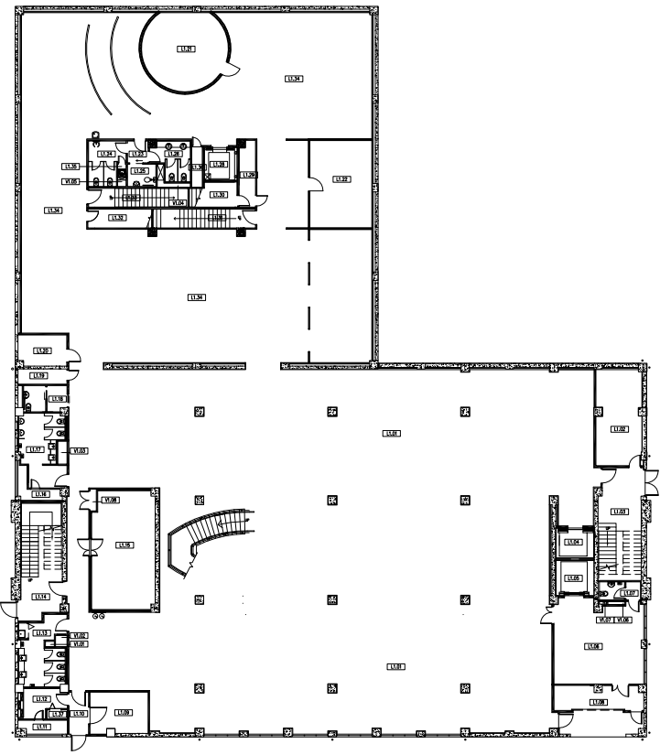
Level 1 020319
19
23
22
20
EXIT 5
21
26
24
25
27
32
34
37
33
35
38
EXIT 6
EXIT 1
31
29
28
30
39
EXIT 3
43
41
42
36
40
EXIT 4
EXIT 2

Slide 3
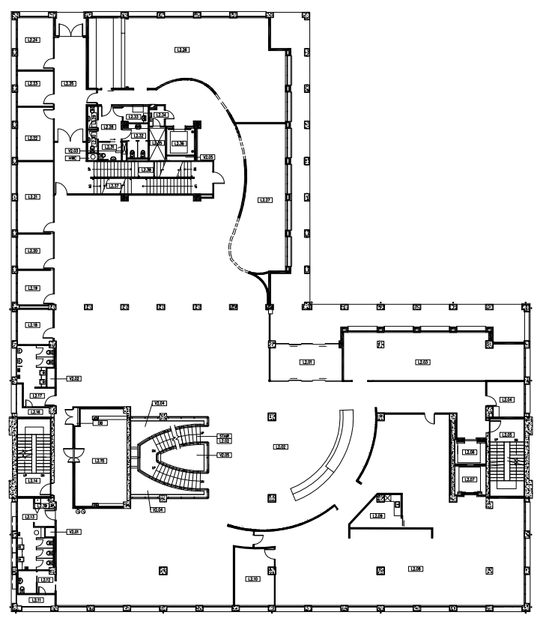
Level 2 020319
EXIT 3
17
10
17b
18
9
12
13
16
14
11
15
EXIT 1
2
1
3
EXIT 2
4
5
7
6
8

Slide 4
Level 1 06-03-19
11
12
13
EXIT 5
18
17
16
15
14
1
2
20
EXIT 6
24
EXIT 1
22
19
25
23
10
8
9
21
EXIT 3
4
5
3
28
6
7
29
26
32
31
30
27
EXIT 4
EXIT 2

Slide 5
Level 2 06-03-19
EXIT 3
44
42
43
35
38
36
34
33
37
39
40
41
48
45
46
52
49
EXIT 1
47
50
51
66
67
EXIT 2
70
69
53
58
65
61
54
55
60
59
57
64
62
63
56

Slide 6
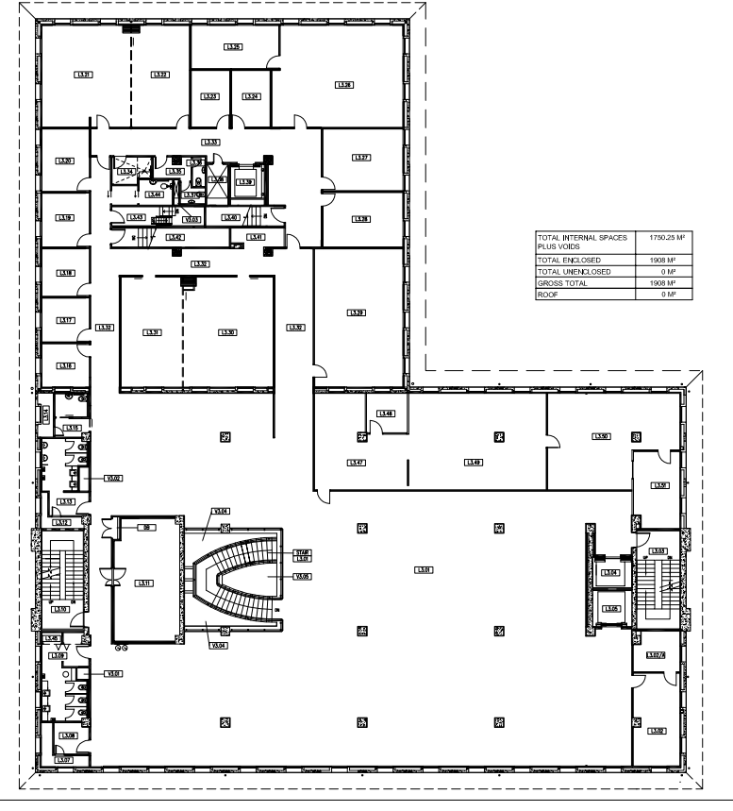
Level 3 06-03-19
EXIT 2
EXIT 1
EXIT 3
79
83
80
73
81
74
77
82
84
89
87
86
85
88
72
78
75
76

Slide 7
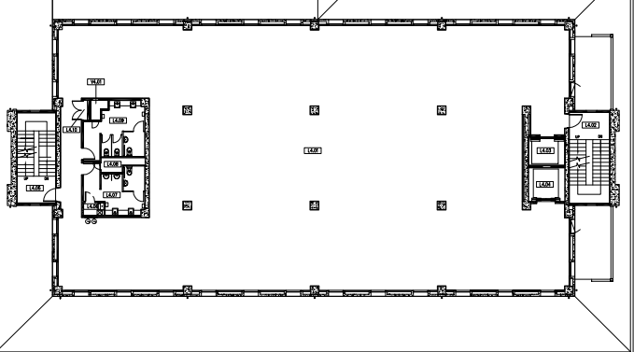
Level 4 06-03-19
91
90
95
94
EXIT 1
EXIT 2
96
93
92
97
95

Slide 8
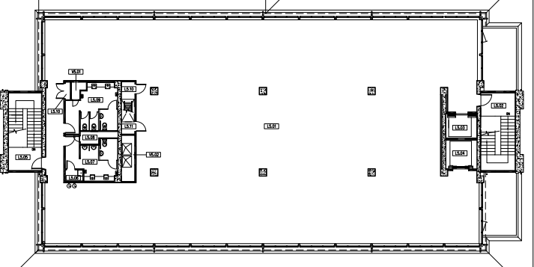
Level 5 06-03-19
99
100
98
107
EXIT 1
108
109
EXIT 2
112
101
102
103
104
105
106
119
118
117
116
110
113
111
114
115

Slide 9
Level 1 11-09-19
29
30
31
34
33
32
EXIT 5
42
43
35
36
45
46
44
41
40
38
39
37
23
20
22
21
48
47
EXIT 6
EXIT 1
49
50
54
53
EXIT 3
52
51
24
28
25
57
27
56
55
26
59
58
EXIT 2
EXIT 4

Slide 10
Level 2 11-09-19
EXIT 3
1
2
EXIT 1
3
4
EXIT 2
126
5
15
9
18
19
125
6
11
13
7
10
12
14
16
17
8

Slide 11
Level 3 11-09-19
EXIT 2
EXIT 3
EXIT 1
62
71
66
70
78
61
65
82
75
74
80
69
73
60
63
64
67
68
72
81
79
77
76

Slide 12
Level 4 11-09-19
84
88
86
83
EXIT 1
87
EXIT 2
90
85
92
91
89
93

Slide 13
Level 5 11-09-19
95
96
97
98
99
113
112
111
110
107
105
94
106
EXIT 1
109
108
123
124
EXIT 2
122
121
100
101
102
103
104
119
118
120
117
116
115
114

Slide 14
Level 1 31-10-19
1
9
2
10
3
11
4
12
5
6
13
8
7
14
EXIT 5
15
28
27
26
25
24
23
16
17
22
19
21
18
20
52
212
211
213
EXIT 6
214
EXIT 1
51
EXIT 3
50
32
47
42
34
46
43
49
35
33
29
39
41
48
31
30
38
44
45
40
37
36
EXIT 2
EXIT 4

Slide 15
Level 2 31-10-19
EXIT 3
71
68
63
60
57
53
72
64
61
58
54
73
69
65
74
66
59
75
70
67
62
56
55
90
92
93
94
EXIT 1
88
91
95
96
89
97
EXIT 2
76
78
82
86
77
87
81
85
80
84
79
83

Slide 16
Level 3 31-10-19
112
111
110
108
109
EXIT 2
EXIT 3
EXIT 1
116
122
123
127
115
117
128
131
104
102
121
124
129
105
100
98
114
118
132
106
125
133
107
103
101
113
99
119
120
126
130

Slide 17
Level 4 31-10-19
152
154
151
153
155
156
174
173
172
171
146
148
147
150
170
169
145
149
EXIT 1
168
167
163
164
162
EXIT 2
166
134
135
136
138
140
142
144
165
161
160
159
158
157
137
139
141
143

Slide 18
Level 5 31-10-19
206
207
208
209
210
190
189
188
187
185
202
204
205
186
201
203
EXIT 1
EXIT 2
176
191
175
192
193
194
195
197
199
183
181
179
178
177
196
198
200
184
182
180

